Slide 1

大模型算法
BERT和GPT3
ZOMI

Slide 2
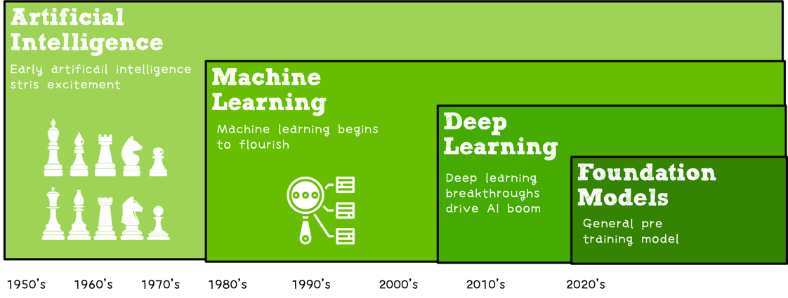

Slide 3
关于本内容
内容背景
大规模分布式训练系统：串行到并行 – 并行处理体系 – 深度学习并行训练
具体内容
大模型训练的挑战：内存墙 – 性能墙 – 效率墙 – 调优墙
分布式训练系统：并行处理硬件架构 – 业界分布式系统分析
分布式并行总体架构：参数服务器模式 – 集合通讯模式
通信原语与协调：通讯协调软硬件 - 通信实现方式 - 通信原语
大模型算法结构：大模型算法发展 – NLP大模型 - CV大模型 – 多模态大模型
分布式并行与同步策略：数据并行 – 模型并行 – 流水并行 – 混合并行
内存和计算优化：ZeRO内存优化 – 混合精度与计算优化

Slide 4
About LLM (Large Language Models)
What are LLM (Large Language Models)
BERT/RoBERTa (Encoder Models)
GPT-3 (Decoder Models)
T5/BART (Encoder Decoder Models)
How to use and Adapt LLM
Prompting for few-shot
Prompting as fine-tuning
In-context learning (Instruction learning)
Downstream Task and Data
NLP downstream Task
Data

Slide 5
ELMo (Em-beddings from Language Models)
Train two separate unidirectional LMs (left-to-right and right-to-left) based on LSTMs
Feature-based approach: pre-trained representations used as input to task-specific models
Trained on single sentences from 1B word benchmark (Chelba et al., 2014)

Slide 6
ELMo (Em-beddings from Language Models)
Train two separate unidirectional LMs (left-to-right and right-to-left) based on LSTMs
Feature-based approach: pre-trained representations used as input to task-specific models
Trained on single sentences from 1B word benchmark (Chelba et al., 2014)

Slide 7
ELMo (Em-beddings from Language Models)
Train one unidirectional LM (left-to-right) based on a deep Transformer decoder
Fine-tuning: all pre-trained parameters are re-used & updated on downstream tasks
Trained on 512-token segments on much longer context dataset BooksCorpus

Slide 8
Sesame Street

Slide 9
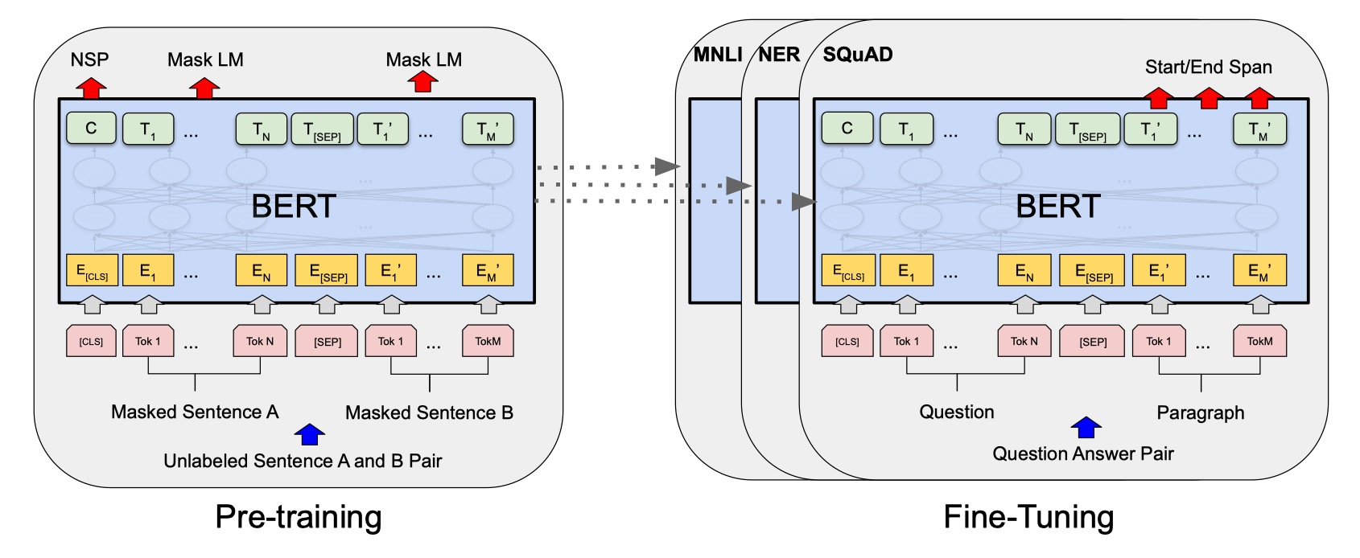
BERT
Key: Fine-tuning approach based on a bidirectional context deep Transformer encoder.
State-of-the-art performance on a large set of sentence-level and token-level tasks.
Pre-training objectives:
masked language modeling
next sentence prediction

Slide 10
BERT: Masked Language Modeling (MLM)
Q: Can we do language modeling with bidirectional models?
A: Mask out k% of the input words, and then predict the masked words.

Slide 11
BERT: Masked Language Modeling (MLM)
Q: Can we do language modeling with bidirectional models?
A: Mask out k% of the input words, and then predict the masked words.
Q: What is the value of k?
Q: How are masked tokens selected?

Slide 12
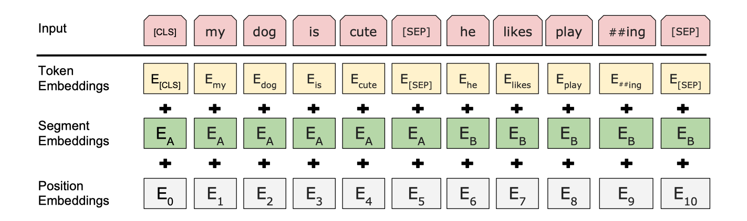
BERT: Next Sentence Prediction (NSP)
NLP downstream tasks require understanding the relationship between two sentences (LI, QA).
NSP is designed to reduce the gap between pre-training and fine-tuning.
[CLS]: a special token always at the beginning
[SEP]: a special token used to separate two segments

Slide 13
BERT: Pre-training Stage
Training corpus: Wikipedia (2.5B) + BooksCorpus (0.8B)
Max sequence size: 512 word pieces (256 for two non-contiguous sequences)
Vocabulary size: 30,000 workpieces (common sub-word units)

Slide 14
BERT: Pre-training Stage
BERT: Pre-training Stage
MLM and NSP are trained together.
[CLS] is pre-trained for NSP.
Tok N representations are trained for MLM.
Trained for 1M steps, batch size 128k.
Model:
BERT-base: 12 layers, 768 hidden size, 12 attention heads, 110M parameters.
BERT-large: 24 layers, 1024 hidden size, 16 attention heads, 340M parameters.

Slide 15
BERT: Fine-tuning Stage
Pretrain once, ﬁnetune many times according downstream task.
Task:
Task 1: Sentence-level tasks.
Task 2: Token-level tasks.

Slide 16
BERT: Fine-tuning Stage
Pretrain once, ﬁnetune many times according downstream task.
Task:
Task 1: Sentence-level tasks.
Task 2: Token-level tasks.

Slide 17
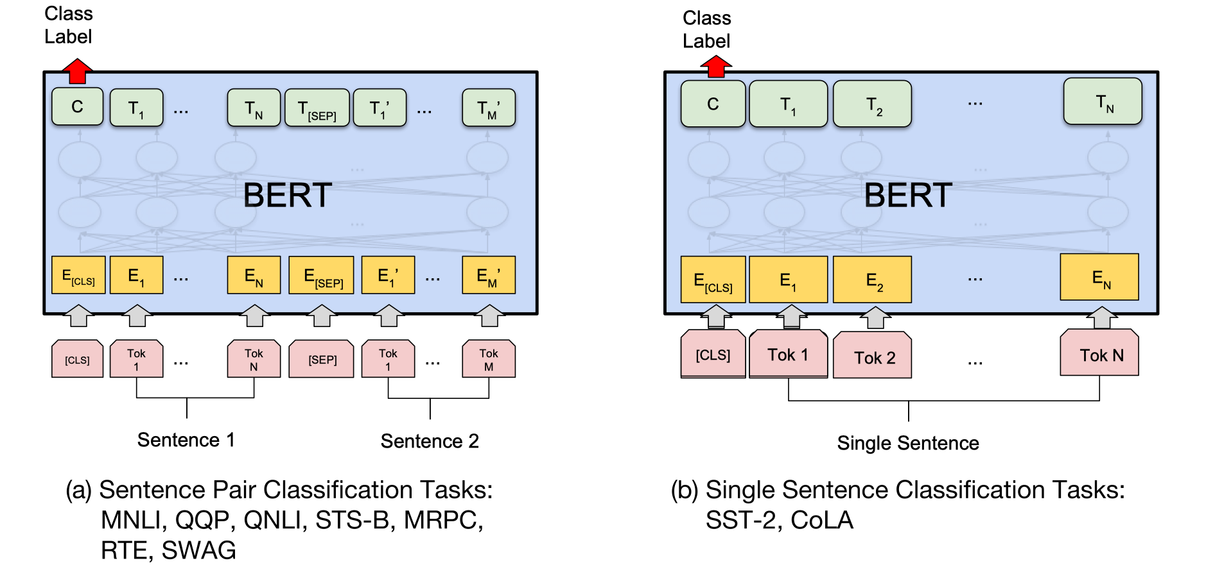
BERT: Fine-tuning Stage
Task 1: Sentence-level tasks.
For sentence pair tasks, use [SEP] to separate the two segments with segment embeddings
Add a linear classiﬁer on top of [CLS] representation and introduce C × h new parameters

Slide 18
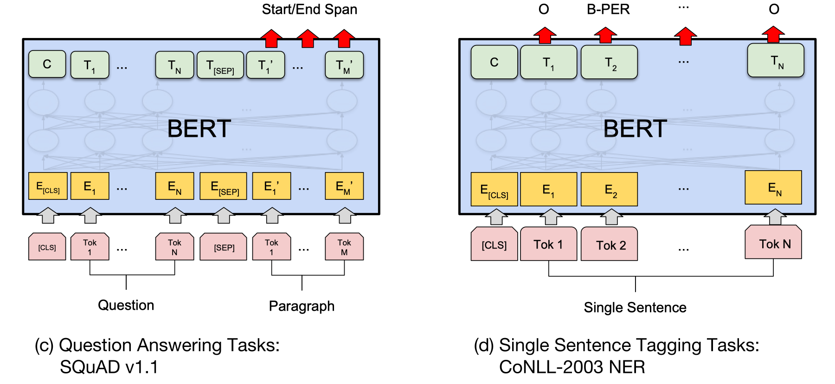
BERT: Fine-tuning Stage
Task 2: Token-level tasks.
For token-level prediction tasks, add linear classiﬁer on top of hidden representations

Slide 19
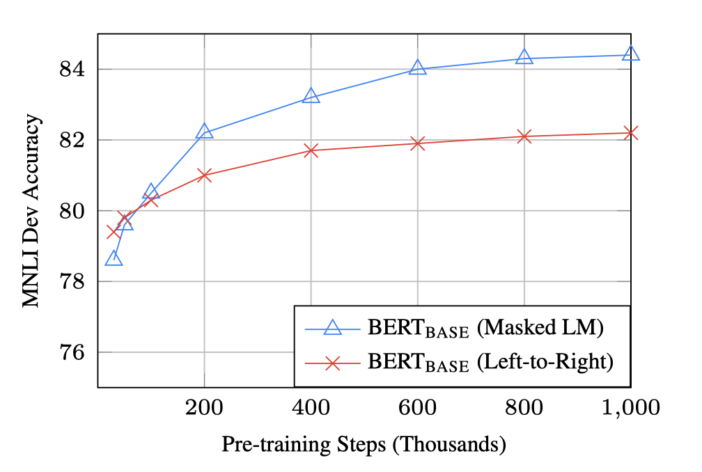
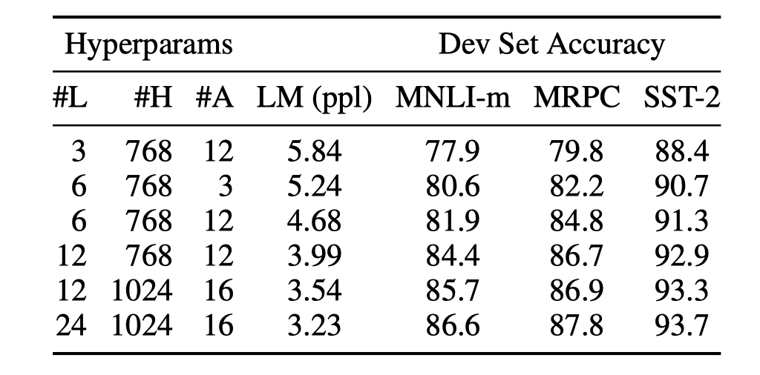
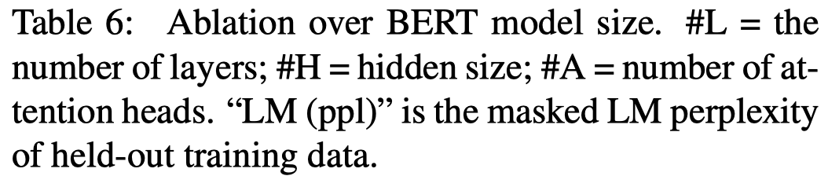
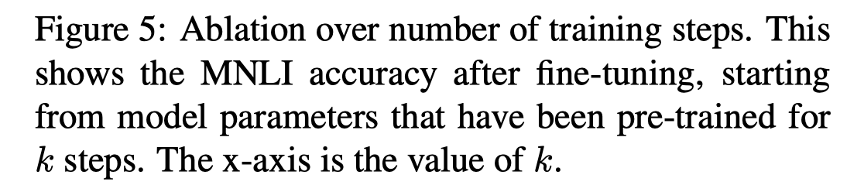
BERT: Experience Result
The bigger, the better
MLM takes slightly longer to converge because it only predicts 15% of tokens

Slide 20
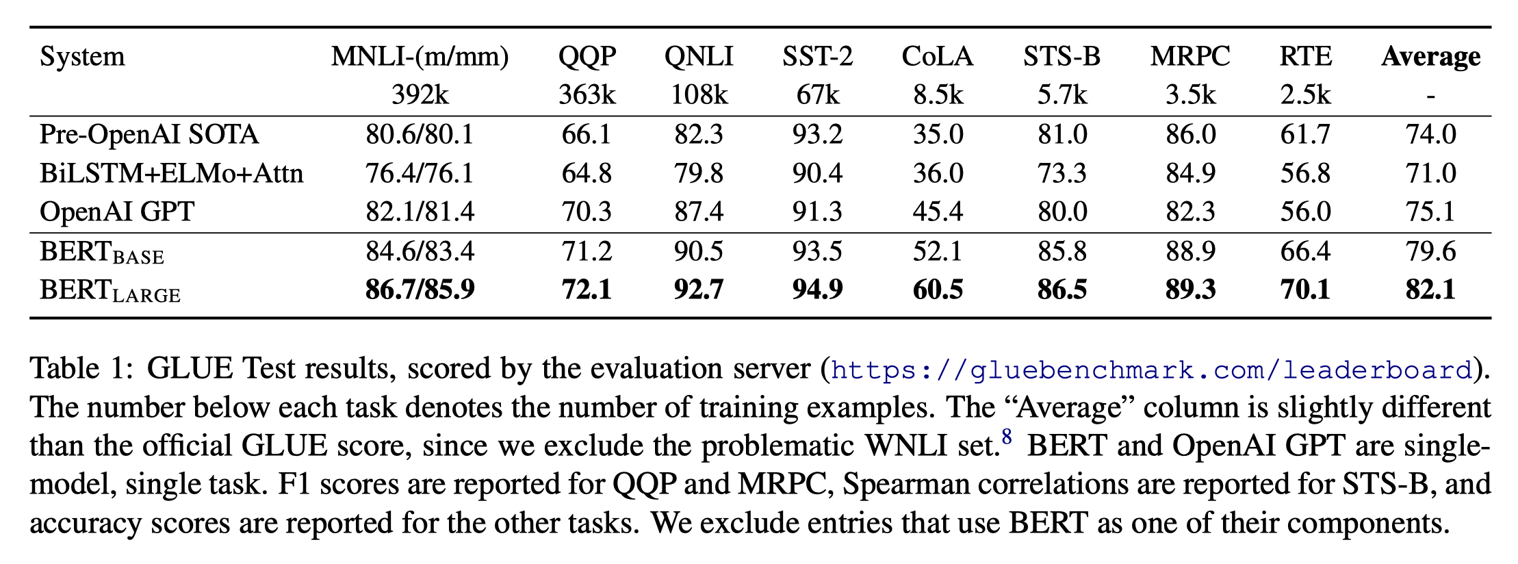
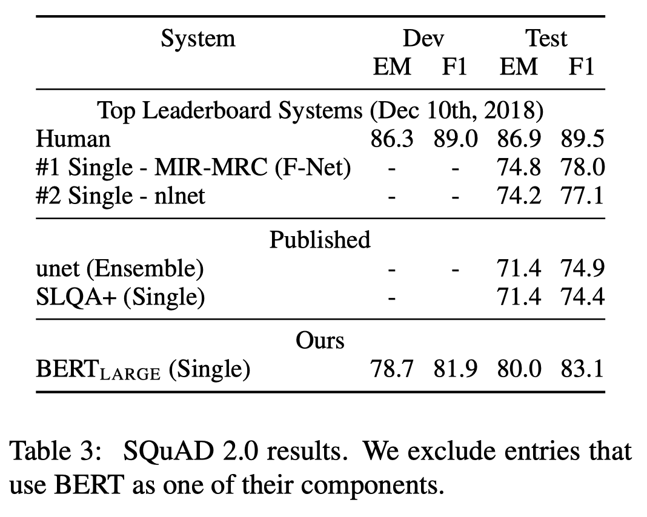
BERT: Experience Result
The bigger, the better
MLM takes slightly longer to converge because it only predicts 15% of tokens

Slide 21
What happened after BERT?
RoBERTa (Liu et al., 2019)
Trained on 10x data & longer, no NSP
Much stronger performance than BERT (e.g., 94.6 vs 90.9 on SQuAD)
Still one of the most popular models to date
ALBERT (Lan et al., 2020)
Increasing model sizes by sharing model parameters across layers
Less storage, much stronger performance but runs slower.
ELECTRA (Clark et al., 2020)
It provides a more efficient training method by predicting 100% of tokens instead of 15% of tokens

Slide 22
What happened after BERT?
Models that handle long contexts:
Longformer, Big Bird, (more than 512 tokens)
Multilingual BERT:
Trained single model on 104 languages from Wikipedia.
Shared 110k WordPiece vocabulary.
BERT extended to different domains:
SciBERT, BioBERT, FinBERT, ClinicalBERT, et la.
Making BERT smaller to use:
DistillBERT, TinyBERT, et la.

Slide 23
Limitations of Pre-training to Fine-tuning like BERT
need large task-specific dataset for fine-tuning.
Collect data for task A and fine-tuning for only task A. Then repeat again.
The task specific model is still fragmented.
One for Token-level tasks, and one for Sentence-level tasks and so on.
Self-supervision only on pre-training stage.
Pre-training on self supervision.

Slide 24
In-context Learning
Define: Using text input of a pre-training Language Model as a form of task specification.
Without Prompt
Prompt
Unscramble the letters into a word:
skitcs = sticks
Zero-Shot
skitcs = sticks
Unscramble the letters into a word:
chira = chair
skitcs = sticks
chira = chair
skitcs = sticks
One-Shot
Unscramble the letters into a word:
chira = chair
pinny = penny
…
skitcs = sticks
chira = chair
pinnei = pinnie
…
skitcs = sticks
Few-Shot
Notes:
prompt是插入到输入示例的一段文本

Slide 25
In-context Learning
GPT-3 "learns" about new tasks through demonstrations in the context, the model initially has extensive pattern recognition capabilities.

Slide 26
In-context Learning

Slide 27
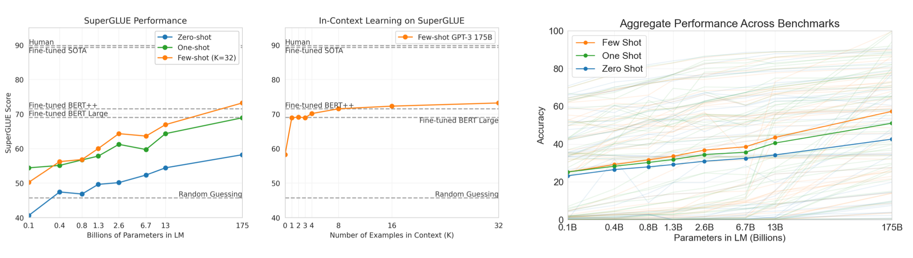
GPT3 with 175B Parameters
GPT-3 is undoubtedly a major breakthrough in the NLP field and even in the AI field. With the super large scale of 175 billion parameters, the language model has the ability to generate news articles that are difficult to distinguish between true and false.
https://jalammar.github.io/how-gpt3-works-visualizations-animations/

Slide 28
Inference
Transformer. Vaswani, Ashish, et al. "Attention is all you need." Advances in neural information processing systems 30 (2017).
BERT Devlin, Jacob, et al. "Bert: Pre-training of deep bidirectional transformers for language understanding." arXiv preprint arXiv:1810.04805 (2018).
GPT3. Brown, Tom, et al. "Language models are few-shot learners." Advances in neural information processing systems 33 (2020): 1877-1901.
T5. Raffel, Colin, et al. "Exploring the limits of transfer learning with a unified text-to-text transformer." J. Mach. Learn. Res. 21.140 (2020): 1-67.
FLAN. Wei, Jason, et al. "Finetuned language models are zero-shot learners." arXiv preprint arXiv:2109.01652 (2021).
COS 597G (Fall 2022): Understanding Large Language Models. https://www.cs.princeton.edu/courses/archive/fall22/cos597G/

Slide 29
Notes:
29

Slide 30
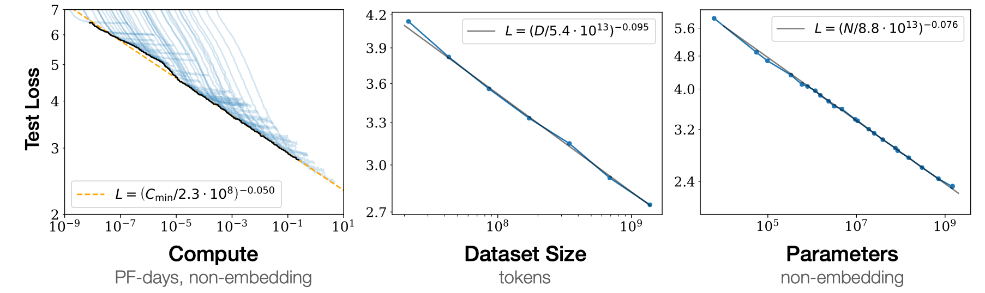
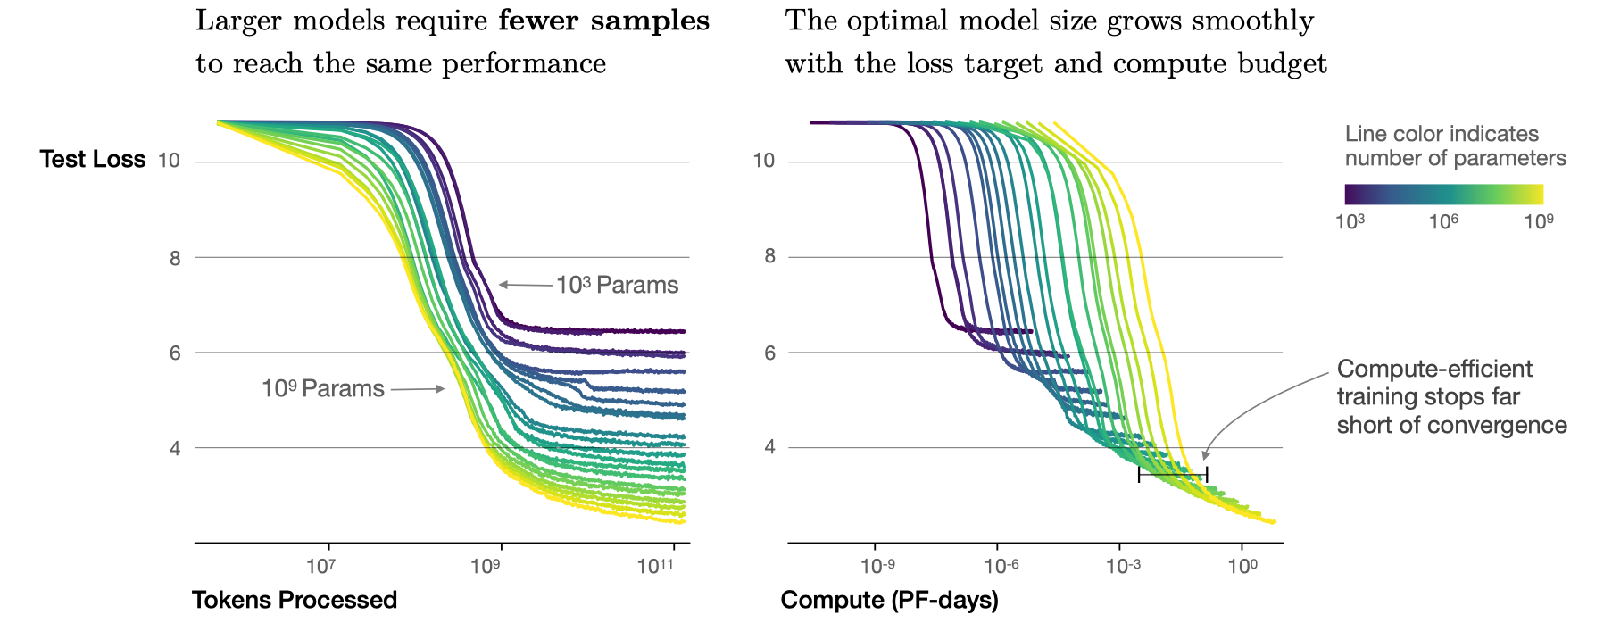
Scaling Up & Prompt
Model size bigger is better.
Optimal model size increases very quickly.

Slide 31
Limitations of Pre-training to Fine-tuning like BERT
Word vectors + task specific
Multi layer RNN
Transformer Pre-training + Fine-tuning
Prompt + Context Learning

